Slide 1


 | Nitte Meenakshi Institute of Technology (AN AUTONOMOUS INSTITUTION AFFILIATED TO VISVESVARAYA TECHNOLOGICAL UNIVERSITY, BELGAUM) PB No. 6429, Yelahanka, Bangalore 560-064, Karnataka Telephone: 080- 22167800, 22167860, Fax: 080 - 22167805
Department of Computer Science and Engineering
Heart Health Prediction WebApp
Team Number: 18PCS_36
Submitted by:
Muskan Khatwani (1NT18IS202)
Neha V M (1NT18CS106)
Kinshuk Chaturvedi (1NT18CS076)
Anubhav Yadav (1NT18CS017)

Slide 2
TABLE OF CONTENTS
 | Nitte Meenakshi Institute of Technology (AN AUTONOMOUS INSTITUTION AFFILIATED TO VISVESVARAYA TECHNOLOGICAL UNIVERSITY, BELGAUM) PB No. 6429, Yelahanka, Bangalore 560-064, Karnataka Telephone: 080- 22167800, 22167860, Fax: 080 - 22167805
Department of Computer Science and Engineering
Introduction
Background
Research Motivation
Problem Statement
Research Objectives
Literature Survey
System Requirements
Dataset
The Design
Analyzing Data
Data Preprocessing
Model Creation and Testing
Conclusion
References

Slide 3
INTRODUCTION
 | Nitte Meenakshi Institute of Technology (AN AUTONOMOUS INSTITUTION AFFILIATED TO VISVESVARAYA TECHNOLOGICAL UNIVERSITY, BELGAUM) PB No. 6429, Yelahanka, Bangalore 560-064, Karnataka Telephone: 080- 22167800, 22167860, Fax: 080 - 22167805
Department of Computer Science and Engineering
Machine learning is a type of artificial intelligence that allows software applications to become more accurate at predicting outcomes without being explicitly programmed to do so.
Machine learning includes supervised, unsupervised, and learning classifiers that are used to predict and find the accuracy of a dataset.
Cardiovascular diseases are a broad term that refers to a variety of conditions that can affect your heart. According to the World Health Organization, (Cardiovascular diseases), CVDs cause 17.9 million deaths worldwide . It is the leading cause of death among adults. With the help of their medical history, our project can help predict who is likely to be diagnosed with heart disease .

Slide 4
BACKGROUND
 | Nitte Meenakshi Institute of Technology (AN AUTONOMOUS INSTITUTION AFFILIATED TO VISVESVARAYA TECHNOLOGICAL UNIVERSITY, BELGAUM) PB No. 6429, Yelahanka, Bangalore 560-064, Karnataka Telephone: 080- 22167800, 22167860, Fax: 080 - 22167805
Department of Computer Science and Engineering
"Health is wealth“ another frequently heard quote sounds too understandable but one gets the gist only when he/she undergoes difficult times due to their own lifestyle. The most important fact is that all these can be avoided easily just by precautionary measure whenever starts giving us the symptoms and hints.
Our project focuses on these atomic factors, their importance, and their role in heart health.
In this project, we attempt to predict the heart health status using relevant data and machine learning algorithms.

Slide 5
RESEARCH MOTIVATION
 | Nitte Meenakshi Institute of Technology (AN AUTONOMOUS INSTITUTION AFFILIATED TO VISVESVARAYA TECHNOLOGICAL UNIVERSITY, BELGAUM) PB No. 6429, Yelahanka, Bangalore 560-064, Karnataka Telephone: 080- 22167800, 22167860, Fax: 080 - 22167805
Department of Computer Science and Engineering
In India, 78 percent of households have single earning family members which mostly are men. Men have a 70-89% more chance of getting a heart attack. In a middle-class family losing the earning member can lead to a very tough life ahead and economic pressure on the entire family. India is a country with the young people as its backbone. It is disheartening that nowadays young Indians are getting heart-related diseases.
Recently we have lost many young actors like Dr. Puneeth Rajkumar, Mr. Sidharth Shukla, the list goes on. The demise of such young and talented personalities has a lot of impact on society.
This problem has driven us to work on the factors contributing to cardiac problems and predict heart problems way before any bad counters.

Slide 6
PROBLEM STATEMENT
 | Nitte Meenakshi Institute of Technology (AN AUTONOMOUS INSTITUTION AFFILIATED TO VISVESVARAYA TECHNOLOGICAL UNIVERSITY, BELGAUM) PB No. 6429, Yelahanka, Bangalore 560-064, Karnataka Telephone: 080- 22167800, 22167860, Fax: 080 - 22167805
Department of Computer Science and Engineering
Prediction of heart health way before any harm based on inputs from the user for different factors affecting heart health, directly and indirectly, integration of the machine learning model in a user-friendly manner, making it easy for anyone to use and achieving a great user experience.
The problem is aiming to automate the process of Heart disease identification and resolve the human error done by medical professionals.

Slide 7
RESEARCH OBJECTIVES
 | Nitte Meenakshi Institute of Technology (AN AUTONOMOUS INSTITUTION AFFILIATED TO VISVESVARAYA TECHNOLOGICAL UNIVERSITY, BELGAUM) PB No. 6429, Yelahanka, Bangalore 560-064, Karnataka Telephone: 080- 22167800, 22167860, Fax: 080 - 22167805
Department of Computer Science and Engineering
To look for factors affecting heart health and mapping them with heart health status.
To identify best ML algorithm which can be used in Heart disease.
Integration of model into a user-friendly format/platform.
Test for accuracy and F1 score for different models.

Slide 8
LITERATURE SURVEY
 | Nitte Meenakshi Institute of Technology (AN AUTONOMOUS INSTITUTION AFFILIATED TO VISVESVARAYA TECHNOLOGICAL UNIVERSITY, BELGAUM) PB No. 6429, Yelahanka, Bangalore 560-064, Karnataka Telephone: 080- 22167800, 22167860, Fax: 080 - 22167805
Department of Computer Science and Engineering
Paper 1
Title: Heart disease prediction using machine learning algorithms
Author: Harshit Jindal, Sarthak Agrawal, Rishabh Khera1, Rachna Jain and Preeti Nagrath
A cardiovascular disease detection model was developed using three ML classification modelling techniques. The algorithms used in building the given model were Logistic regression, Random Forest Classifier and KNN. They concluded that accuracy of KNN was highest between the three algorithms that they used i.e. 88.52%.

Slide 9
 | Nitte Meenakshi Institute of Technology (AN AUTONOMOUS INSTITUTION AFFILIATED TO VISVESVARAYA TECHNOLOGICAL UNIVERSITY, BELGAUM) PB No. 6429, Yelahanka, Bangalore 560-064, Karnataka Telephone: 080- 22167800, 22167860, Fax: 080 - 22167805
Department of Computer Science and Engineering
Paper 2
Title: Prediction of Cardiovascular Disease Using Machine Learning Algorithms
Author: Dinesh Kumar G , Arumugaraj K, Santhosh Kumar D , Mareeswari V
This paper was nonethical study which aimed to use available machine learning techniques in R software. The machine learning techniques used were Logistic regression, Random Forest Classifier and SVM. The accuracy recorded for these models by the authors were:
Algorithm Name | Accuracy
Logistic Regression | 86.51%
Random Forest | 80.89%
SVM | 79.77%

Slide 10
SYSTEM REQUIREMENTS
 | Nitte Meenakshi Institute of Technology (AN AUTONOMOUS INSTITUTION AFFILIATED TO VISVESVARAYA TECHNOLOGICAL UNIVERSITY, BELGAUM) PB No. 6429, Yelahanka, Bangalore 560-064, Karnataka Telephone: 080- 22167800, 22167860, Fax: 080 - 22167805
Department of Computer Science and Engineering
Software Requirements:
Programming Language : Python
Machine Learning : Scikit-learn, Streamlit
Data Preprocessing : NumPy, Pandas
Data Visualization : Seaborn, Matplotlib

Slide 11
 | Nitte Meenakshi Institute of Technology (AN AUTONOMOUS INSTITUTION AFFILIATED TO VISVESVARAYA TECHNOLOGICAL UNIVERSITY, BELGAUM) PB No. 6429, Yelahanka, Bangalore 560-064, Karnataka Telephone: 080- 22167800, 22167860, Fax: 080 - 22167805
Department of Computer Science and Engineering
Hardware Requirements:
Cloud Computing(Kaggle, Google Collab)
Existing System To date
RAM : 8 Gb min
HDD/SSD space : 64 GB
GPU : GeForce 940 or higher with 4 Gb
CPU : i5 5th Gen min.

Slide 12
DATASET
 | Nitte Meenakshi Institute of Technology (AN AUTONOMOUS INSTITUTION AFFILIATED TO VISVESVARAYA TECHNOLOGICAL UNIVERSITY, BELGAUM) PB No. 6429, Yelahanka, Bangalore 560-064, Karnataka Telephone: 080- 22167800, 22167860, Fax: 080 - 22167805
Department of Computer Science and Engineering
Title: Heart Disease Databases
Source Information:
Creators :
Hungarian Institute of Cardiology. Budapest: Andras Janosi, M.D
University Hospital, Zurich, Switzerland: William Steinbrunn, M.D
University Hospital, Basel, Switzerland: Matthias Pfisterer, M.D
V.A. Medical Center, Long Beach and Cleveland Clinic Foundation: Robert Detrano, M.D., Ph.D.
Donor :
David W. Aha (aha@ics.uci.edu) (714) 856-8779
3. Date: July, 1988

Slide 13
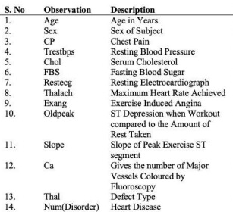
 | Nitte Meenakshi Institute of Technology (AN AUTONOMOUS INSTITUTION AFFILIATED TO VISVESVARAYA TECHNOLOGICAL UNIVERSITY, BELGAUM) PB No. 6429, Yelahanka, Bangalore 560-064, Karnataka Telephone: 080- 22167800, 22167860, Fax: 080 - 22167805
Department of Computer Science and Engineering
This database contains 76 attributes, but all published experiments refer to using a subset of 14 of them. In particular, the Cleveland database is the only one that has been used by ML researchers to this date. The "goal" field refers to the presence of heart disease in the patient. It is integer valued from 0 (no presence) and 1. Experiments with the Cleveland database have concentrated on simply attempting to distinguish presence from absence.

Slide 14
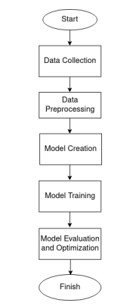
THE DESIGN
 | Nitte Meenakshi Institute of Technology (AN AUTONOMOUS INSTITUTION AFFILIATED TO VISVESVARAYA TECHNOLOGICAL UNIVERSITY, BELGAUM) PB No. 6429, Yelahanka, Bangalore 560-064, Karnataka Telephone: 080- 22167800, 22167860, Fax: 080 - 22167805
Department of Computer Science and Engineering

Slide 15
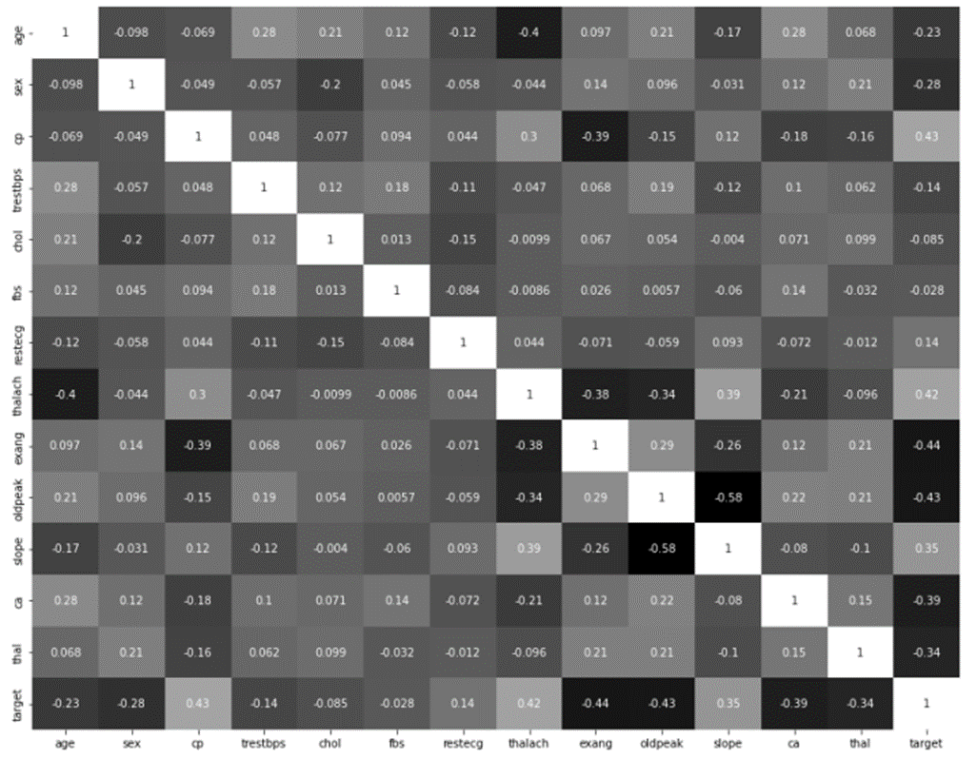
ANALYZING DATA
 | Nitte Meenakshi Institute of Technology (AN AUTONOMOUS INSTITUTION AFFILIATED TO VISVESVARAYA TECHNOLOGICAL UNIVERSITY, BELGAUM) PB No. 6429, Yelahanka, Bangalore 560-064, Karnataka Telephone: 080- 22167800, 22167860, Fax: 080 - 22167805
Department of Computer Science and Engineering
Heat-Map:
From Figure, it can be seen that correlation between independent variables is not high.

Slide 16
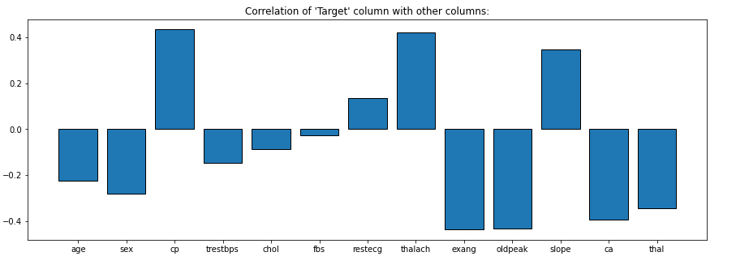
 | Nitte Meenakshi Institute of Technology (AN AUTONOMOUS INSTITUTION AFFILIATED TO VISVESVARAYA TECHNOLOGICAL UNIVERSITY, BELGAUM) PB No. 6429, Yelahanka, Bangalore 560-064, Karnataka Telephone: 080- 22167800, 22167860, Fax: 080 - 22167805
Department of Computer Science and Engineering
Similarly, it can be seen from the above correlation that there is no single feature that has a very high correlation with the target.

Slide 17
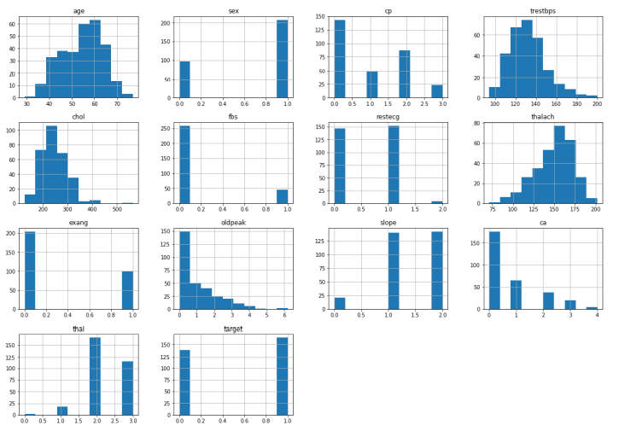
 | Nitte Meenakshi Institute of Technology (AN AUTONOMOUS INSTITUTION AFFILIATED TO VISVESVARAYA TECHNOLOGICAL UNIVERSITY, BELGAUM) PB No. 6429, Yelahanka, Bangalore 560-064, Karnataka Telephone: 080- 22167800, 22167860, Fax: 080 - 22167805
Department of Computer Science and Engineering
Histogram:
The figure depicts how each feature and label is spread throughout multiple ranges, confirming the requirement for scaling. Following that, the discrete bars indicate that each of them is a categorical variable. Before implementing Machine Learning, these categorical variables must be addressed.

Slide 18
 | Nitte Meenakshi Institute of Technology (AN AUTONOMOUS INSTITUTION AFFILIATED TO VISVESVARAYA TECHNOLOGICAL UNIVERSITY, BELGAUM) PB No. 6429, Yelahanka, Bangalore 560-064, Karnataka Telephone: 080- 22167800, 22167860, Fax: 080 - 22167805
Department of Computer Science and Engineering
Target Bar Chart :
An unbalanced dataset is one in which the distribution of the classes in the dataset is highly skewed. This indicates that a dataset is skewed towards one of the dataset's classes. If the dataset favors one class, an algorithm trained on the same data will favor the same class. From Figure, it can be seen that the target is balanced.

Slide 19
DATA PREPROCESSING
 | Nitte Meenakshi Institute of Technology (AN AUTONOMOUS INSTITUTION AFFILIATED TO VISVESVARAYA TECHNOLOGICAL UNIVERSITY, BELGAUM) PB No. 6429, Yelahanka, Bangalore 560-064, Karnataka Telephone: 080- 22167800, 22167860, Fax: 080 - 22167805
Department of Computer Science and Engineering
1. Handling Null Values.
There are no null values in the dataset.
2. Check for Duplicate Values.
There is one duplicate value, which is removed.
3. Check for Outliers (Boxplots, Z Score vs IQR Score).
We found outliers in the coulmns trestbps, chol, thalach and oldpeak.
4. Handling Categorical Values.
Dummy columns must be created for columns sex, cp, fbs, restecg, exang, slope, ca, thal.
5 .Standardization V/S Normalization.
It is much less affected by outliers and uses mean and standard deviation for scaling.

Slide 20
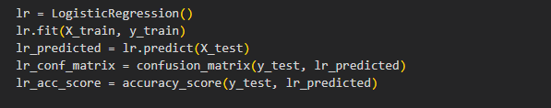
MODEL CREATION AND TRAINING
 | Nitte Meenakshi Institute of Technology (AN AUTONOMOUS INSTITUTION AFFILIATED TO VISVESVARAYA TECHNOLOGICAL UNIVERSITY, BELGAUM) PB No. 6429, Yelahanka, Bangalore 560-064, Karnataka Telephone: 080- 22167800, 22167860, Fax: 080 - 22167805
Department of Computer Science and Engineering
Logistic Regression:
This classifier predicts the output of a categorical dependent variable. Therefore the outcome must be a categorical or discrete value.
It can be either Yes or No, 0 or 1, true or False, etc. but instead of giving the exact value as 0 and 1, it gives the probabilistic values which lie between 0 and 1.

Slide 21
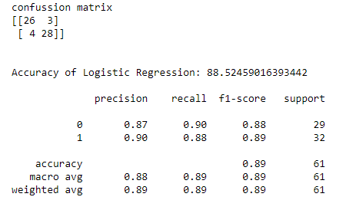
 | Nitte Meenakshi Institute of Technology (AN AUTONOMOUS INSTITUTION AFFILIATED TO VISVESVARAYA TECHNOLOGICAL UNIVERSITY, BELGAUM) PB No. 6429, Yelahanka, Bangalore 560-064, Karnataka Telephone: 080- 22167800, 22167860, Fax: 080 - 22167805
Department of Computer Science and Engineering

Slide 22
 | Nitte Meenakshi Institute of Technology (AN AUTONOMOUS INSTITUTION AFFILIATED TO VISVESVARAYA TECHNOLOGICAL UNIVERSITY, BELGAUM) PB No. 6429, Yelahanka, Bangalore 560-064, Karnataka Telephone: 080- 22167800, 22167860, Fax: 080 - 22167805
Department of Computer Science and Engineering
K-Nearest Neighbors Classifier:
The K-Nearest Neighbor method is based on the Supervised Learning approach.
It assumes that the new case/data and existing cases are comparable and places the new case in the category that is most like the existing categories.
This method saves all available data and classifies a new data point based on its similarity to the existing data.
This implies that fresh data may be quickly sorted into a well-defined category using the K-NN method.
This approach may be used for both regression and classification, however, it is more commonly utilized for classification tasks.

Slide 23
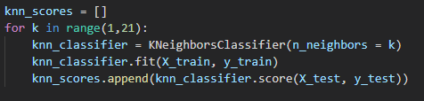
 | Nitte Meenakshi Institute of Technology (AN AUTONOMOUS INSTITUTION AFFILIATED TO VISVESVARAYA TECHNOLOGICAL UNIVERSITY, BELGAUM) PB No. 6429, Yelahanka, Bangalore 560-064, Karnataka Telephone: 080- 22167800, 22167860, Fax: 080 - 22167805
Department of Computer Science and Engineering
As the number of neighbors can be varied. We varied them from 1 to 20 neighbors and calculated the test score in each case.

Slide 24
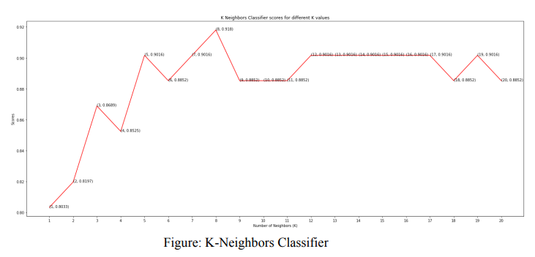
 | Nitte Meenakshi Institute of Technology (AN AUTONOMOUS INSTITUTION AFFILIATED TO VISVESVARAYA TECHNOLOGICAL UNIVERSITY, BELGAUM) PB No. 6429, Yelahanka, Bangalore 560-064, Karnataka Telephone: 080- 22167800, 22167860, Fax: 080 - 22167805
Department of Computer Science and Engineering
Its clear that model achieved the maximum score of 91.8% when the number of neighbors was 8.

Slide 25
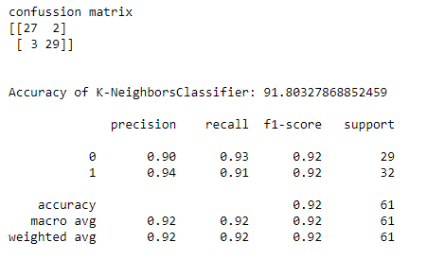
 | Nitte Meenakshi Institute of Technology (AN AUTONOMOUS INSTITUTION AFFILIATED TO VISVESVARAYA TECHNOLOGICAL UNIVERSITY, BELGAUM) PB No. 6429, Yelahanka, Bangalore 560-064, Karnataka Telephone: 080- 22167800, 22167860, Fax: 080 - 22167805
Department of Computer Science and Engineering

Slide 26
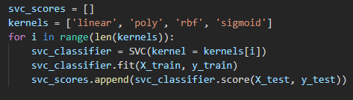
 | Nitte Meenakshi Institute of Technology (AN AUTONOMOUS INSTITUTION AFFILIATED TO VISVESVARAYA TECHNOLOGICAL UNIVERSITY, BELGAUM) PB No. 6429, Yelahanka, Bangalore 560-064, Karnataka Telephone: 080- 22167800, 22167860, Fax: 080 - 22167805
Department of Computer Science and Engineering
Support Vector Classifier:
This classifier aims at forming a hyperplane that can separate the classes as much as possible by adjusting the distance between the data points and the hyperplane.
There are several kernels based on which the hyperplane is decided. We tried four kernels namely, linear, poly, rbf, and sigmoid.

Slide 27
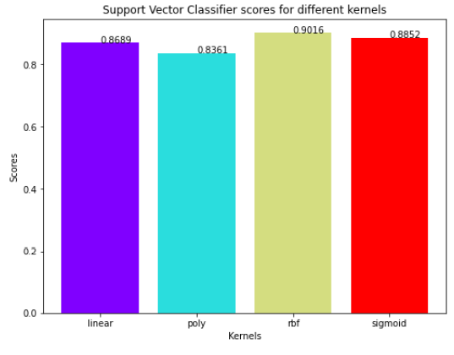
 | Nitte Meenakshi Institute of Technology (AN AUTONOMOUS INSTITUTION AFFILIATED TO VISVESVARAYA TECHNOLOGICAL UNIVERSITY, BELGAUM) PB No. 6429, Yelahanka, Bangalore 560-064, Karnataka Telephone: 080- 22167800, 22167860, Fax: 080 - 22167805
Department of Computer Science and Engineering
It can be seen from the figure; the RBF kernel performed the best for this dataset and achieved a score of 90.16%.

Slide 28
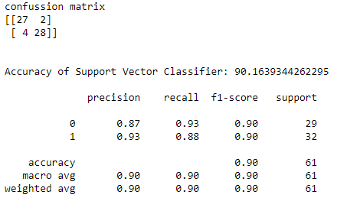
 | Nitte Meenakshi Institute of Technology (AN AUTONOMOUS INSTITUTION AFFILIATED TO VISVESVARAYA TECHNOLOGICAL UNIVERSITY, BELGAUM) PB No. 6429, Yelahanka, Bangalore 560-064, Karnataka Telephone: 080- 22167800, 22167860, Fax: 080 - 22167805
Department of Computer Science and Engineering

Slide 29
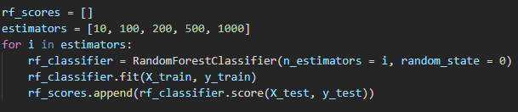
 | Nitte Meenakshi Institute of Technology (AN AUTONOMOUS INSTITUTION AFFILIATED TO VISVESVARAYA TECHNOLOGICAL UNIVERSITY, BELGAUM) PB No. 6429, Yelahanka, Bangalore 560-064, Karnataka Telephone: 080- 22167800, 22167860, Fax: 080 - 22167805
Department of Computer Science and Engineering
Random Forest Classifier:
This classifier takes the concept of decision trees to the next level. It creates a forest of trees where each tree is formed by a random selection of features from the total features.
Here, we can vary the number of trees that will be used to predict the class.
We calculate test scores over 10, 100, 200, 500 and 1000 trees.

Slide 30
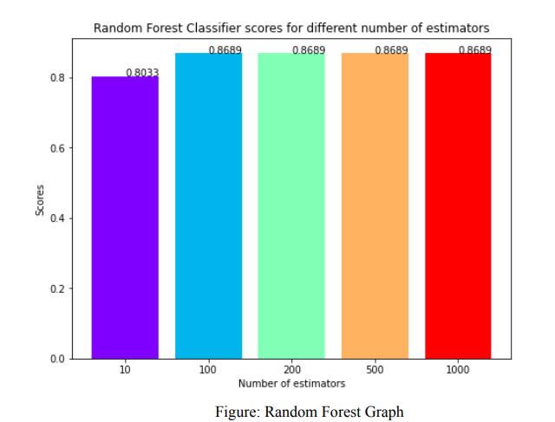
 | Nitte Meenakshi Institute of Technology (AN AUTONOMOUS INSTITUTION AFFILIATED TO VISVESVARAYA TECHNOLOGICAL UNIVERSITY, BELGAUM) PB No. 6429, Yelahanka, Bangalore 560-064, Karnataka Telephone: 080- 22167800, 22167860, Fax: 080 - 22167805
Department of Computer Science and Engineering
We can see that the maximum score of 86.88% was achieved for 100, 200,500, and 1000 trees.

Slide 31
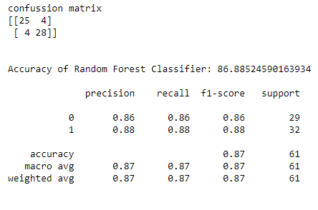
 | Nitte Meenakshi Institute of Technology (AN AUTONOMOUS INSTITUTION AFFILIATED TO VISVESVARAYA TECHNOLOGICAL UNIVERSITY, BELGAUM) PB No. 6429, Yelahanka, Bangalore 560-064, Karnataka Telephone: 080- 22167800, 22167860, Fax: 080 - 22167805
Department of Computer Science and Engineering

Slide 32
 | Nitte Meenakshi Institute of Technology (AN AUTONOMOUS INSTITUTION AFFILIATED TO VISVESVARAYA TECHNOLOGICAL UNIVERSITY, BELGAUM) PB No. 6429, Yelahanka, Bangalore 560-064, Karnataka Telephone: 080- 22167800, 22167860, Fax: 080 - 22167805
Department of Computer Science and Engineering
CONCLUSION
The project involved analysis of the heart disease patient dataset with proper data processing.
Four models were trained and tested with maximum scores (accuracy), below follows a comparison of our results with the base papers:
Models\Results(%) | Base Paper 1 | Base Paper 2 | Our Results
Logistic Regression | 87.5 | 86.51 | 88.52
KNN | 88.52 | N/A | 91.80
SVM | N/A | 79.77 | 90.16
Random Forest | 85.1 | 80.89 | 86.88
Among these models, K Neighbors Classifier performs the best.

Slide 33
 | Nitte Meenakshi Institute of Technology (AN AUTONOMOUS INSTITUTION AFFILIATED TO VISVESVARAYA TECHNOLOGICAL UNIVERSITY, BELGAUM) PB No. 6429, Yelahanka, Bangalore 560-064, Karnataka Telephone: 080- 22167800, 22167860, Fax: 080 - 22167805
Department of Computer Science and Engineering
The key factors from the dataset leading to heart diseases from the dataset are:
1. Exercise Induced Angina
2. Chest Pain
3. ST Depression when workout compared to the amount of Rest taken
4. Maximum heart rate achieved
5. Major vessels coloured by fluoroscopy
Below follows a comparison of F1 score for the all 4 models:
Models\Results(%) | F1_score
Logistic Regression | 89
KNN | 90
SVM | 92
Random Forest | 87
Among these models, K Neighbors Classifier performs the best.

Slide 34
REFERENCES
 | Nitte Meenakshi Institute of Technology (AN AUTONOMOUS INSTITUTION AFFILIATED TO VISVESVARAYA TECHNOLOGICAL UNIVERSITY, BELGAUM) PB No. 6429, Yelahanka, Bangalore 560-064, Karnataka Telephone: 080- 22167800, 22167860, Fax: 080 - 22167805
Department of Computer Science and Engineering
Sneha Grampurohit and Chetan Sagarnal "Disease Prediction using Machine Learning Algorithms" 2020 International Conference for Emerging Technology (INCET) Belgaum, India. Jun 5-7, 2020
Chinmayi Chitnis and Roger Lee “Improving Health-Care Systems by Disease Prediction” 2018 International Conference on Computational Science and Computational Intelligence (CSCI)
R. Aroul canessane,R. Dhanalakshmi, B. Muthukumar, Cheedella Venkata Sailaja, Cheedella Venkata Sailaja, S. Dhamodaran “ Diabetes To Heart Disease: A Survey” 2019 Fifth International Conference on Science Technology Engineering and Mathematics (ICONSTEM)

Slide 35
 | Nitte Meenakshi Institute of Technology (AN AUTONOMOUS INSTITUTION AFFILIATED TO VISVESVARAYA TECHNOLOGICAL UNIVERSITY, BELGAUM) PB No. 6429, Yelahanka, Bangalore 560-064, Karnataka Telephone: 080- 22167800, 22167860, Fax: 080 - 22167805
Department of Computer Science and Engineering
C. Kalaiselvi and Dr. G .M. Nasira, Ph.D. “A New Approach for Diagnosis of Diabetes and Prediction of Cancer using ANFIS” 2018 World Congress on Computing and Communication Technologies
Harshit Jindal “Heart disease prediction using machine learning algorithms” 2021 IOP Conf. Ser.: Mater. Sci. Eng. 1022 012072
Valentina O. Puntmann “Outcomes of Cardiovascular Magnetic Resonance Imaging in Patients Recently Recovered From Coronavirus Disease 2019 (COVID-19)” July 27, 2020. doi:10.1001/jamacardio.2020.3557
Lukma Ali and H Ahmed Anwar Relationships between Obesity and Cardiovascular Diseases Published in final edited form as: J Health Care Poor Underserved. 2011; 22(4 Suppl): 61–72. doi: 10.1353/hpu.2011.0166

Slide 36
 | Nitte Meenakshi Institute of Technology (AN AUTONOMOUS INSTITUTION AFFILIATED TO VISVESVARAYA TECHNOLOGICAL UNIVERSITY, BELGAUM) PB No. 6429, Yelahanka, Bangalore 560-064, Karnataka Telephone: 080- 22167800, 22167860, Fax: 080 - 22167805
Department of Computer Science and Engineering
Thank You

